Slide 1
Analysis of the I35 Mutations of Galactin-8
Megan Brady, Amber Jessop, Krystle Reiss

Slide 2
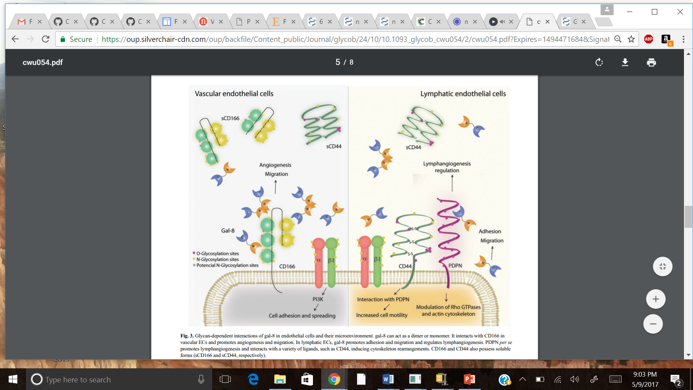
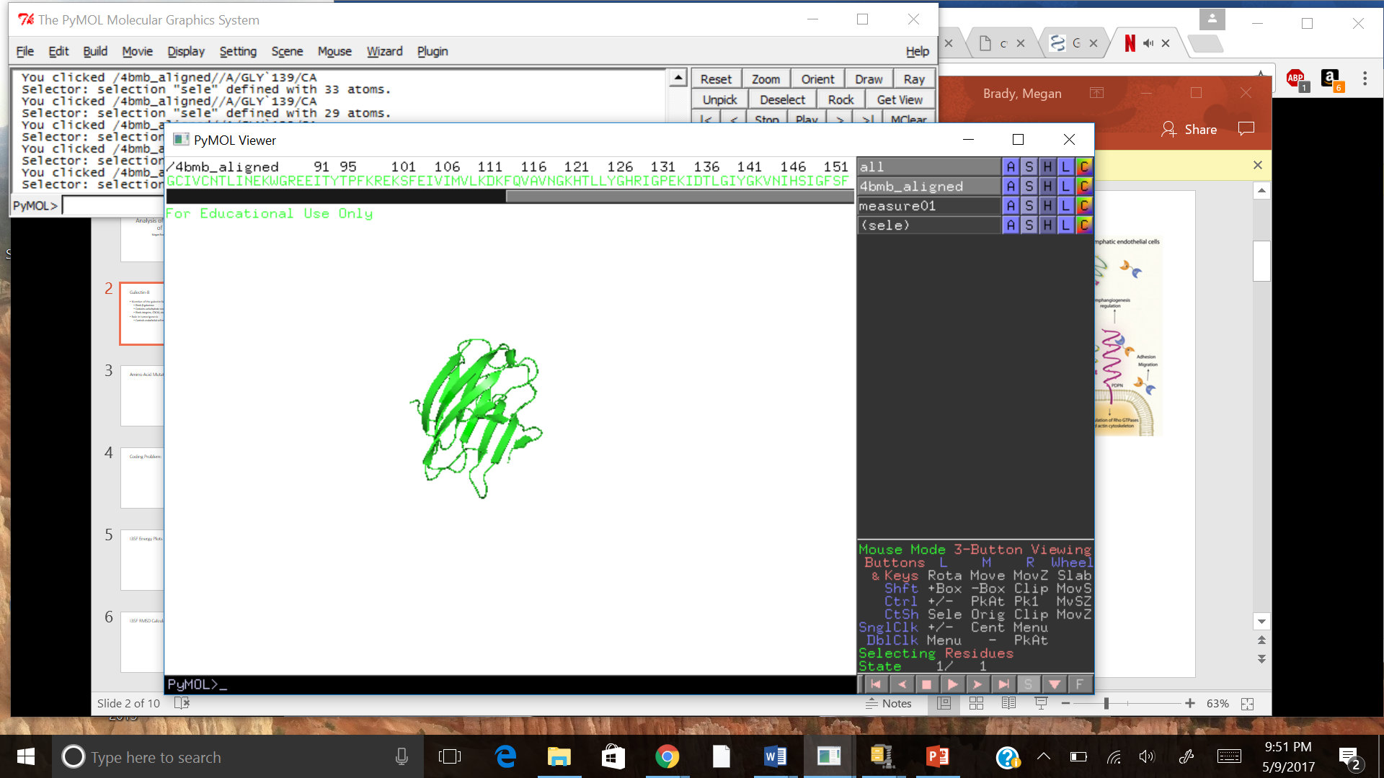
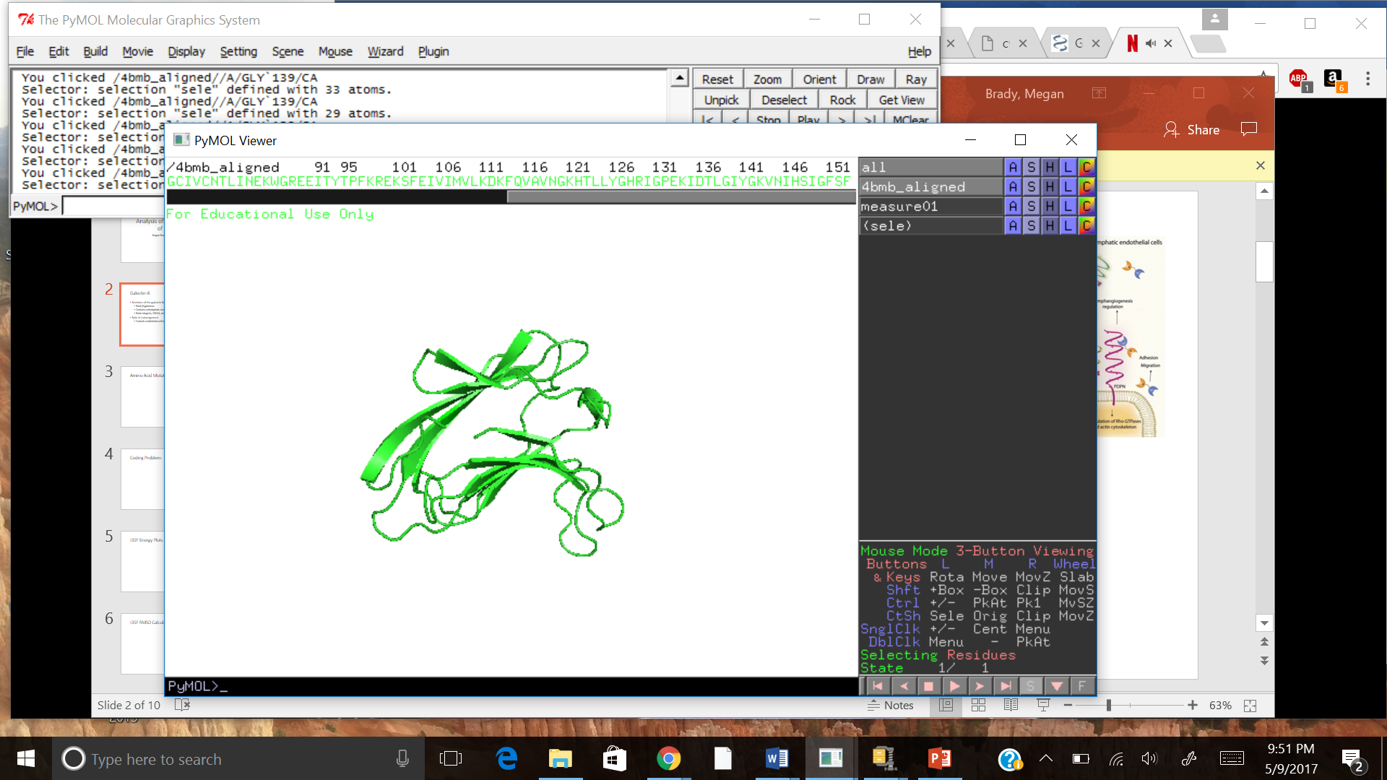
Galectin-8
Member of the galectin family
Binds β-galactose
Contains carbohydrate recognition domain (CRD)
Binds integrins, CDC44, etc.
Role in tumorigenesis
Controls endothelial cell migration and angiogenesis
Cummings and Liu, 2009
Troncoso et al. 2014
PDB 4BMB

Slide 3
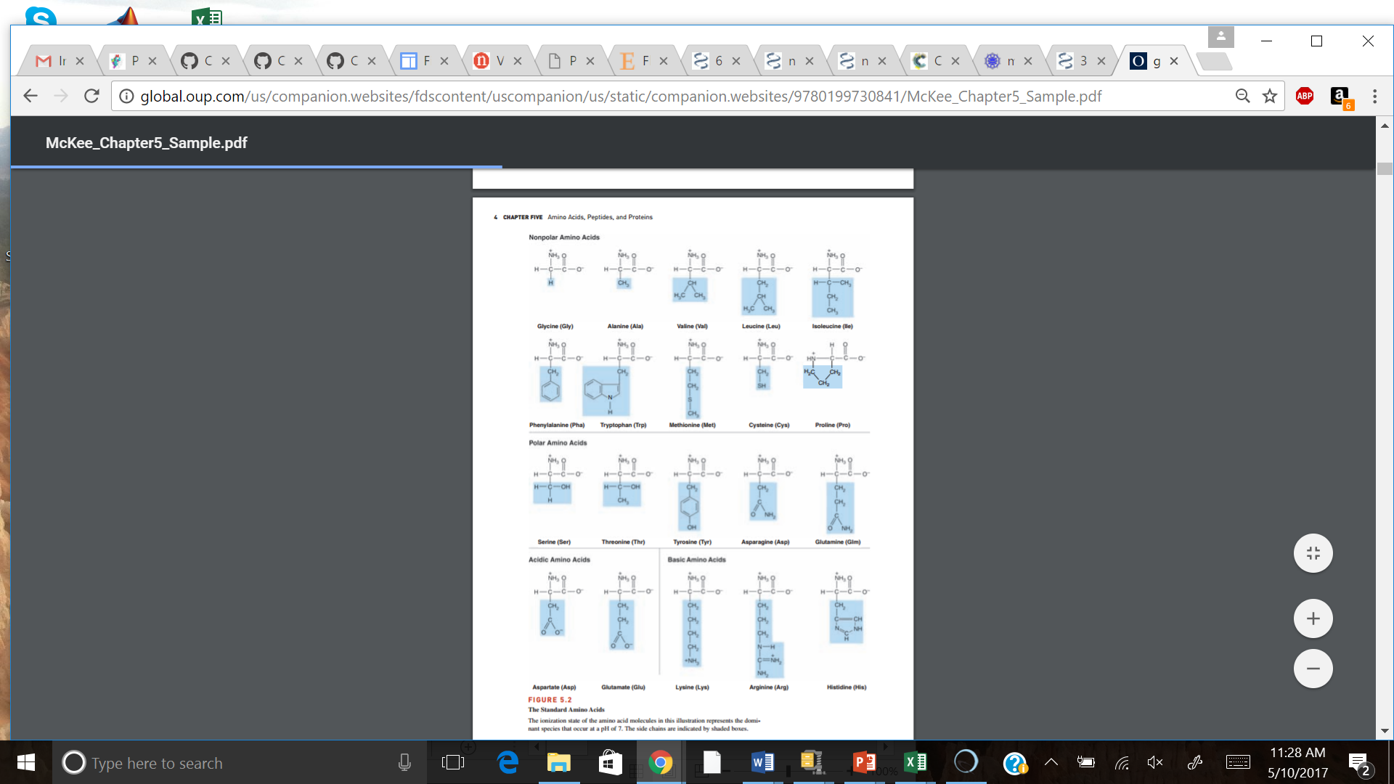
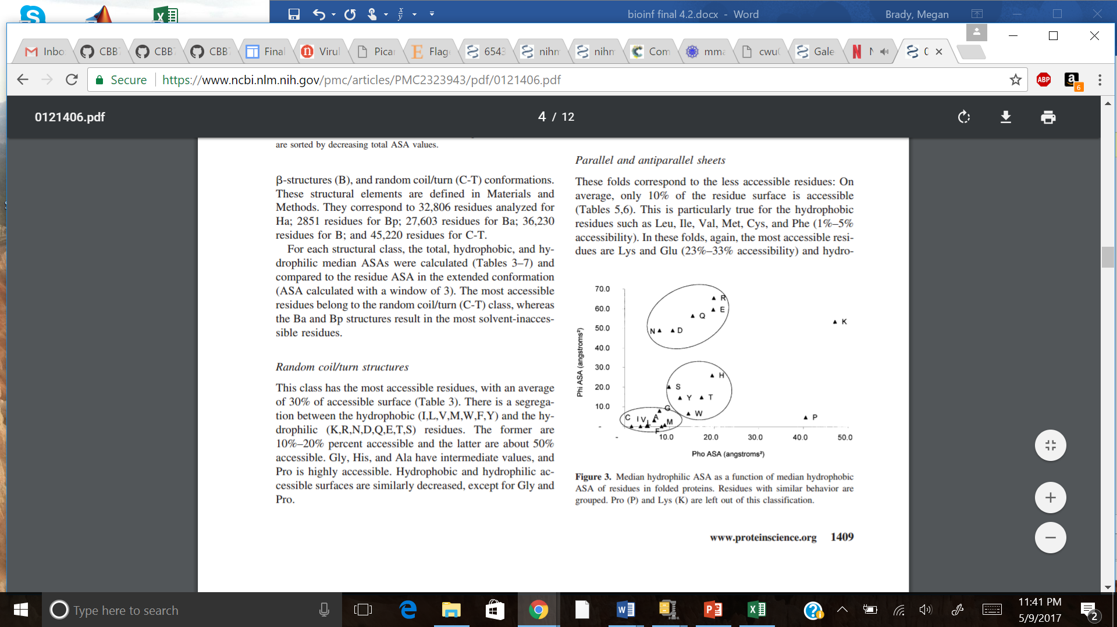
Amino Acid Mutations
Size
Charge
Hydrophobic effect
Change in potential energy
McKee, T., & McKee, J. R. (2012). Biochemistry: The molecular basis of life. Oxford: Oxford University Press.
Lins et al. 2003

Slide 4
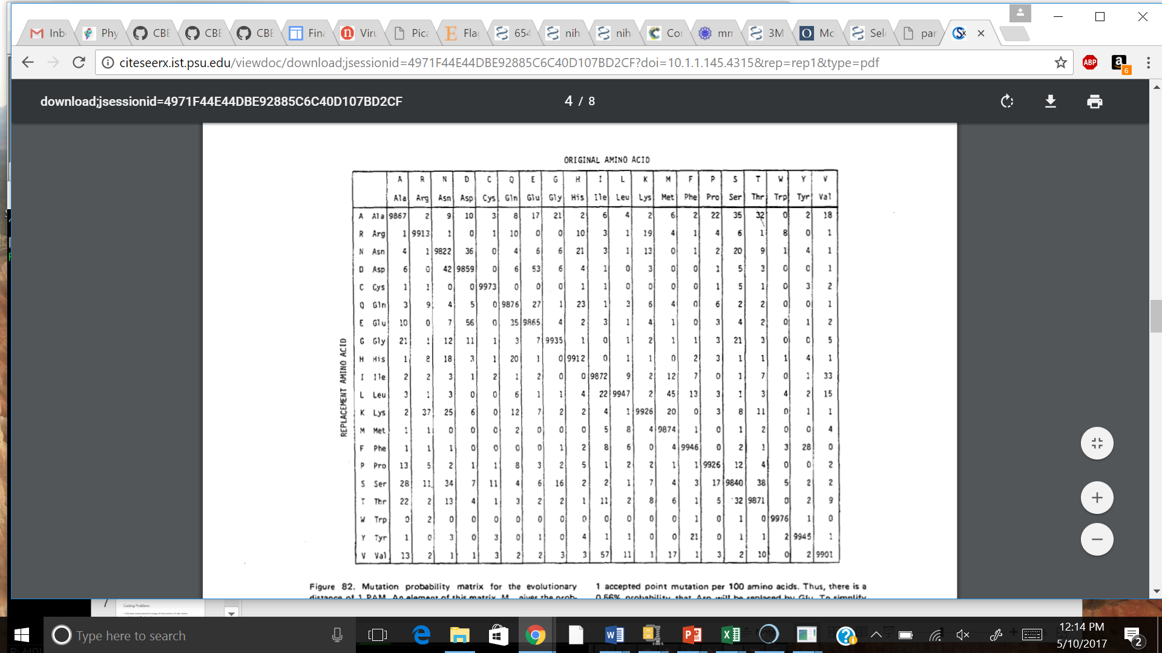
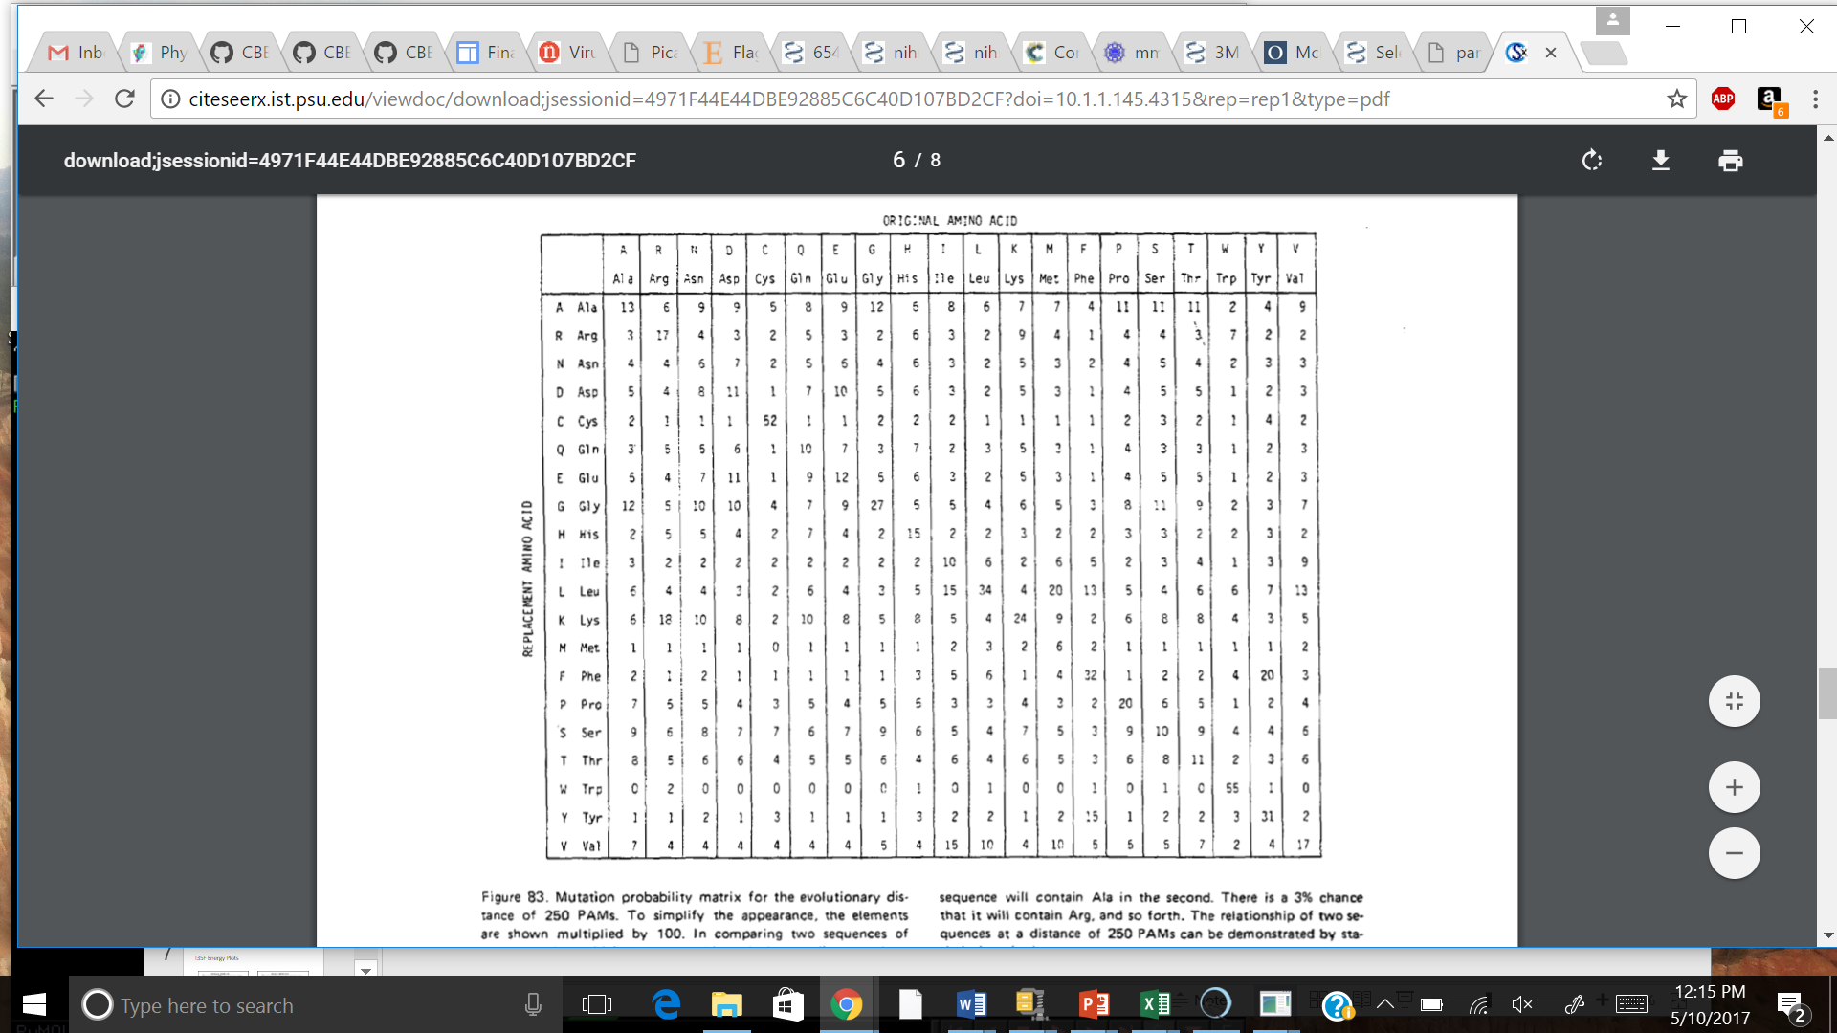
Common Mutations
PAM 1
PAM 250
Dayhoff et al. 1978

Slide 5
Common Mutations
PAM 1
PAM 250
Dayhoff et al. 1978

Slide 6
Common Mutations
PAM 1
PAM 250
Dayhoff et al. 1978

Slide 7
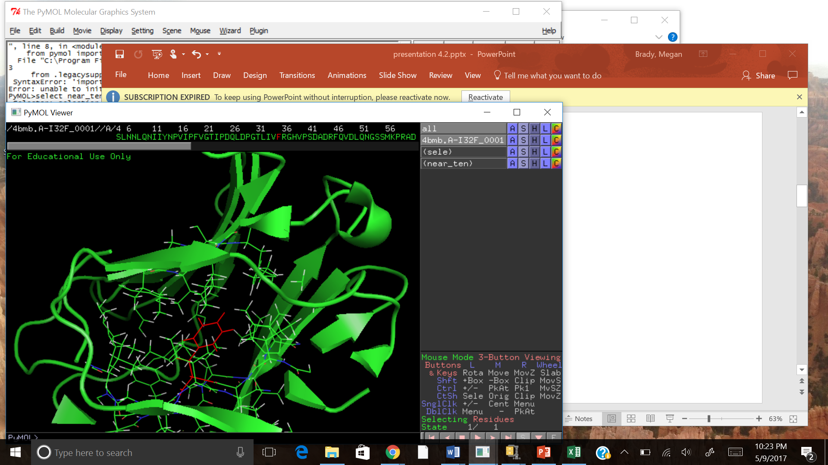
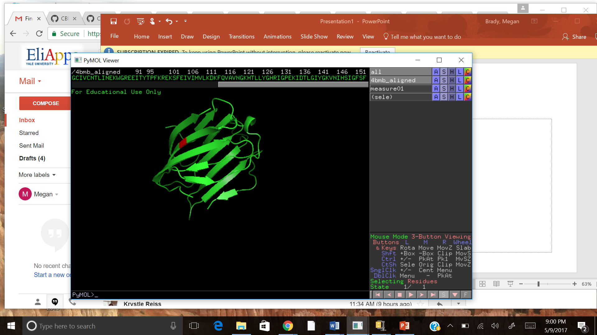
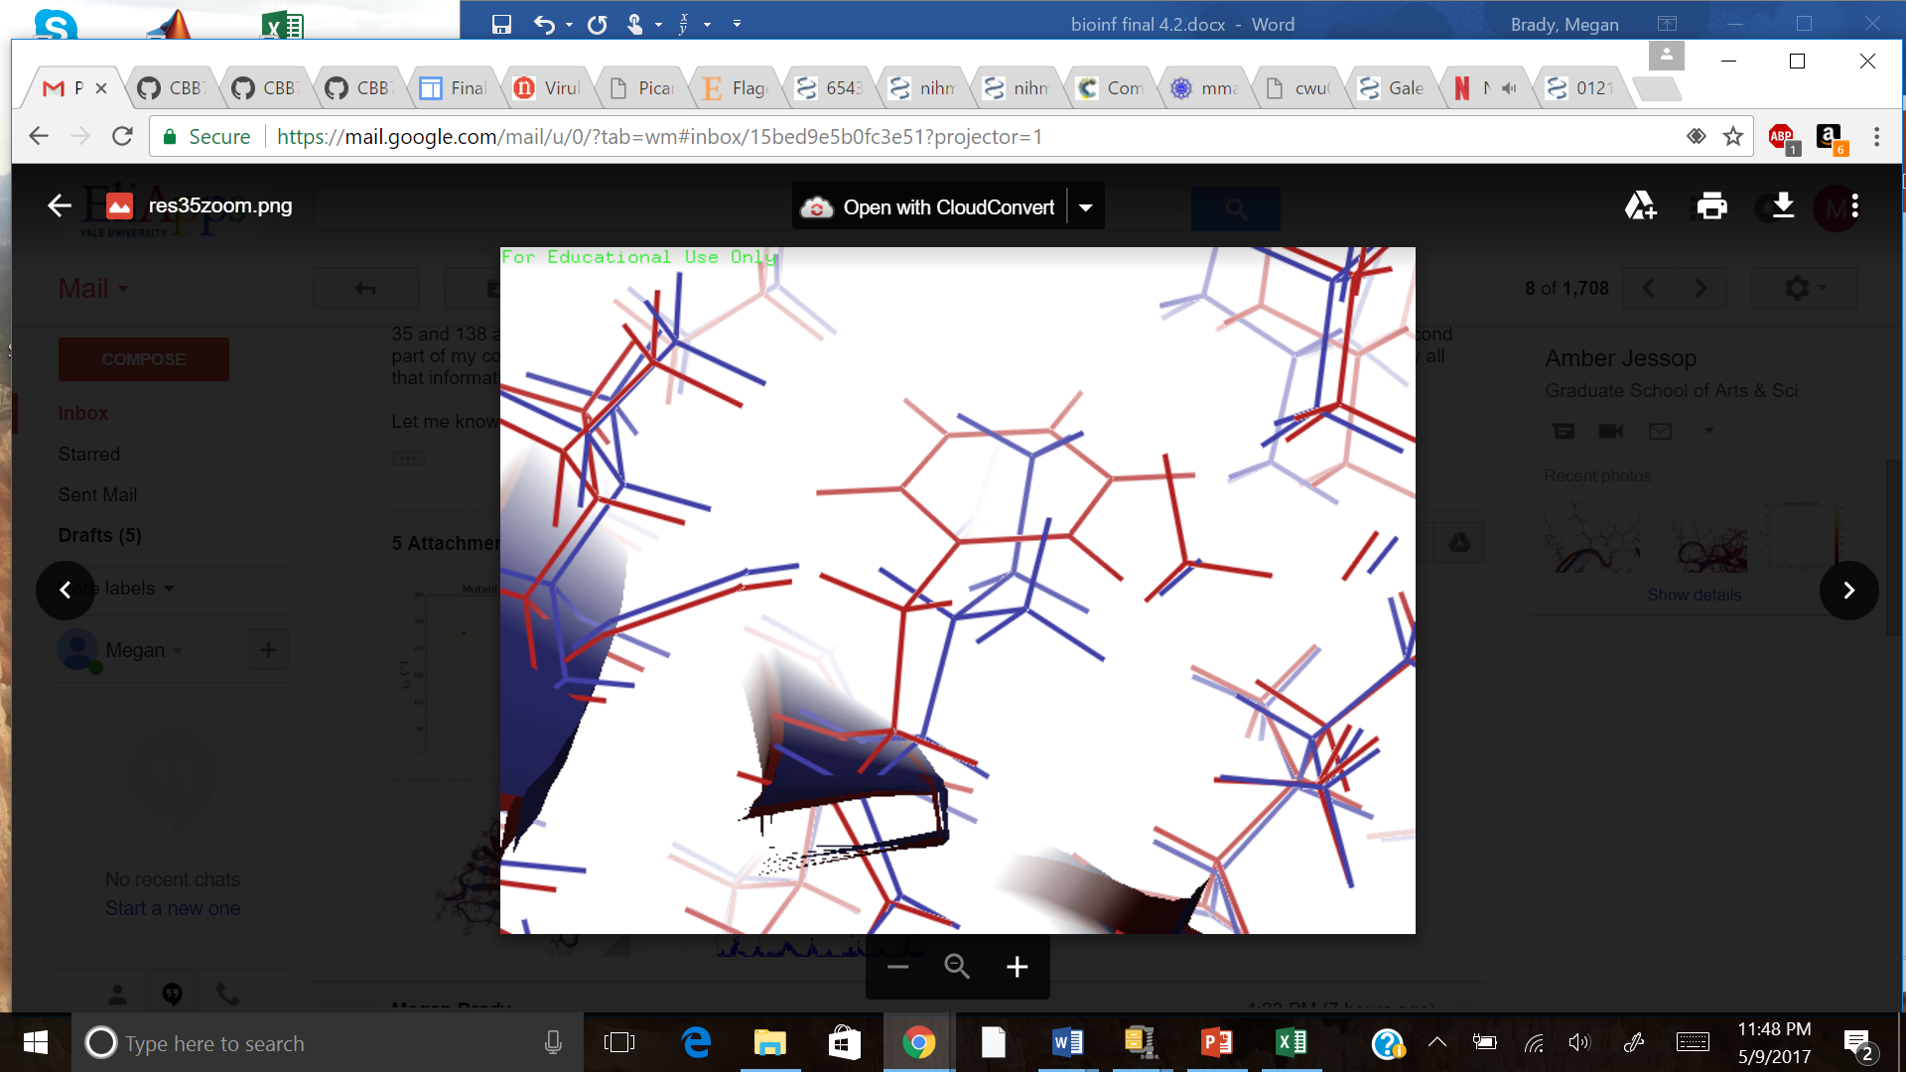
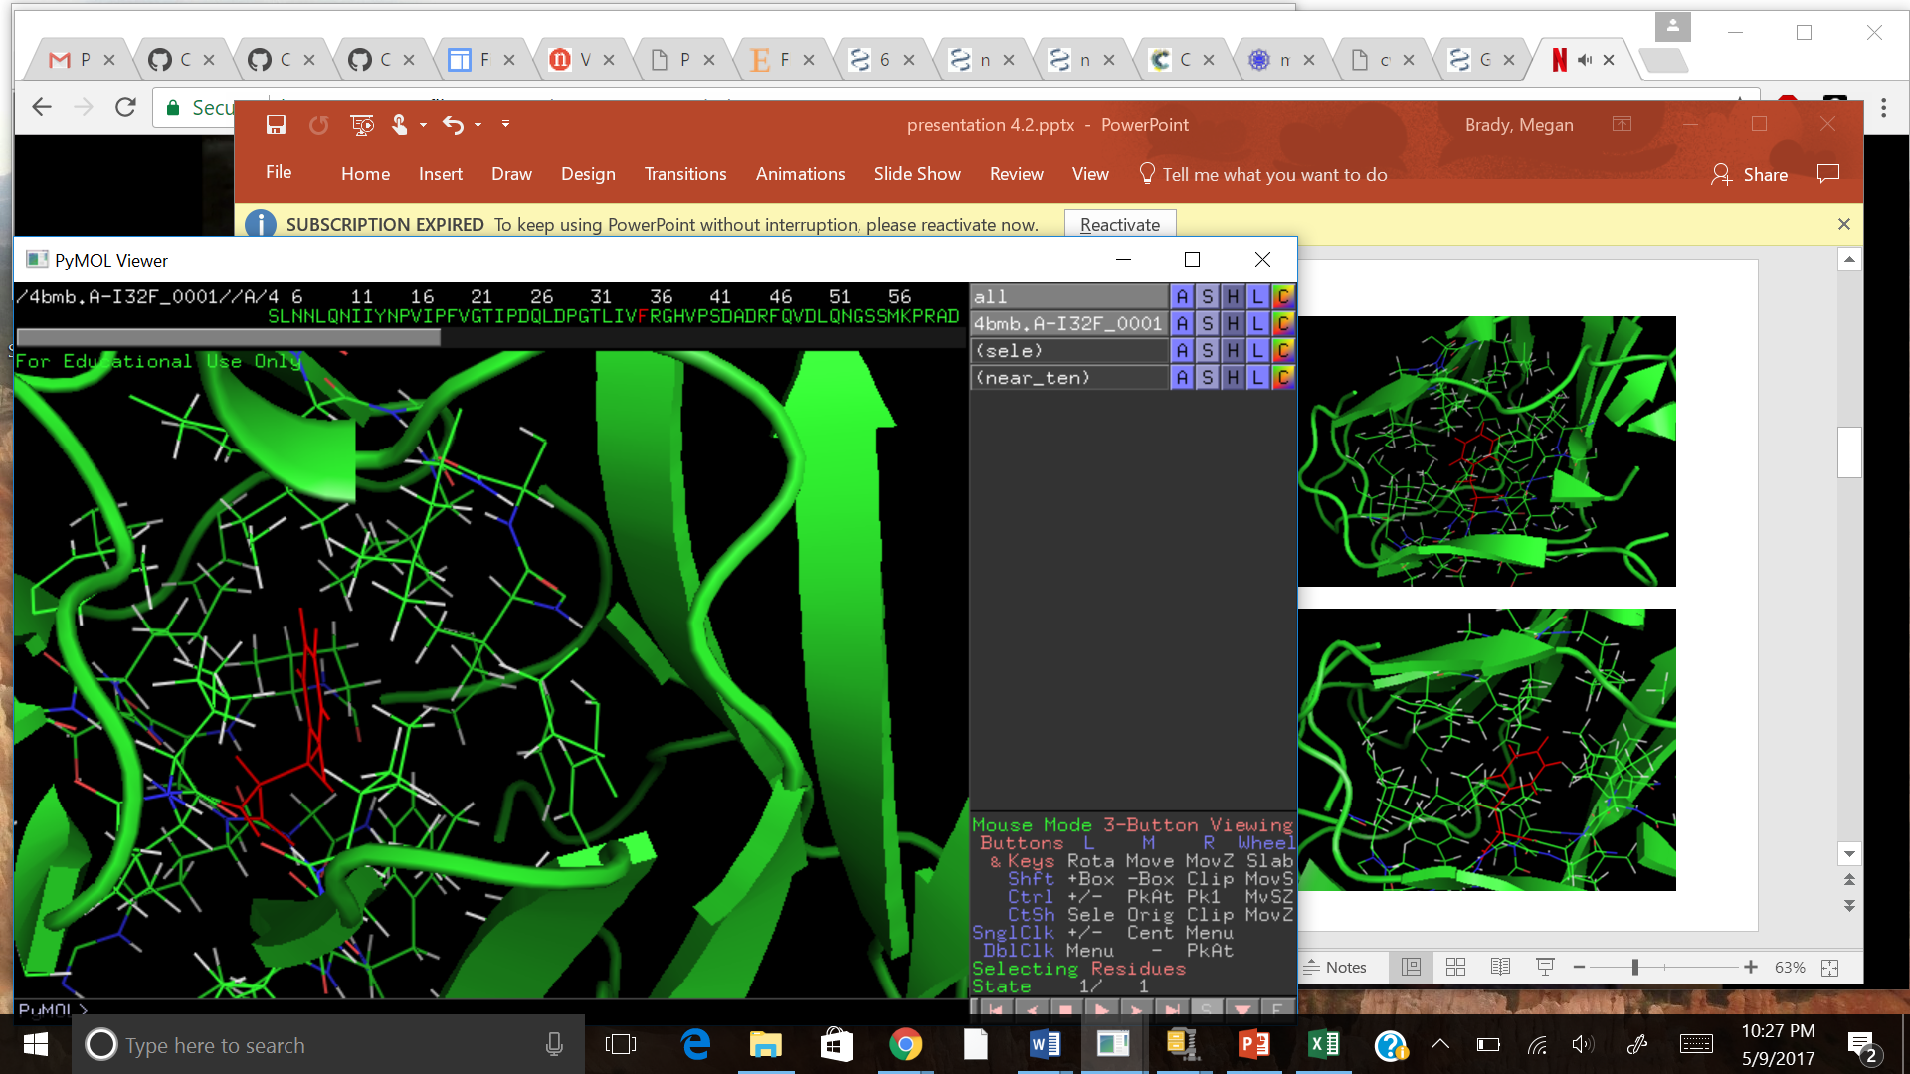
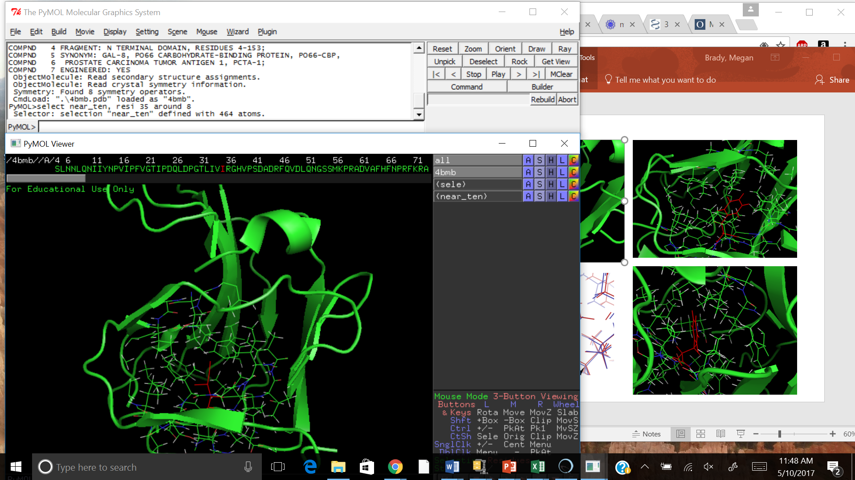
I35F
Rosetta Energy: +4.821
→ Damaging mutation
RMSD
I35
I35F

Slide 8
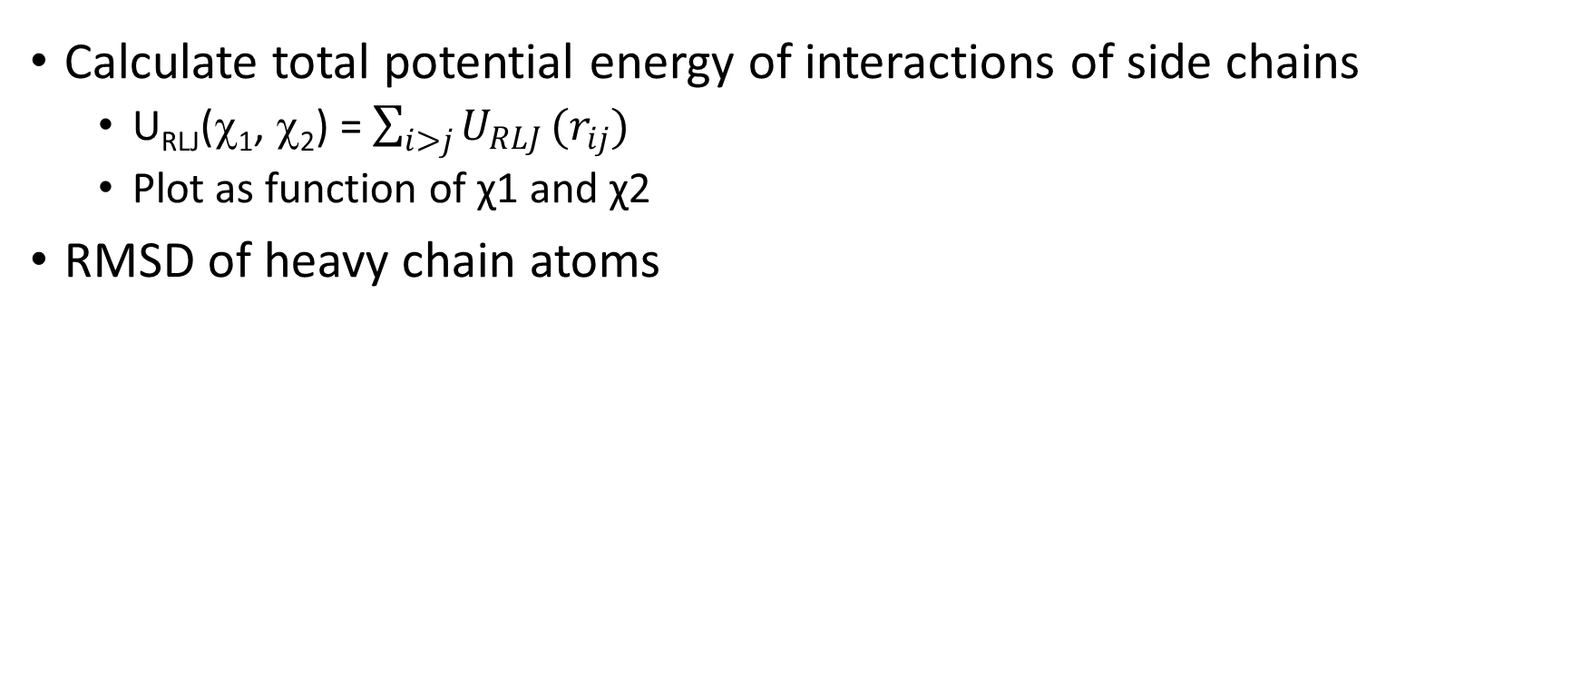
Coding Problem:
Calculate total potential energy of interactions of side chains
U_{RLJ}(χ₁, χ₂) = $\sum_{i>j}{U_{RLJ}}(r_{ij})$
Plot as function of χ1 and χ2
RMSD of heavy chain atoms

Slide 9
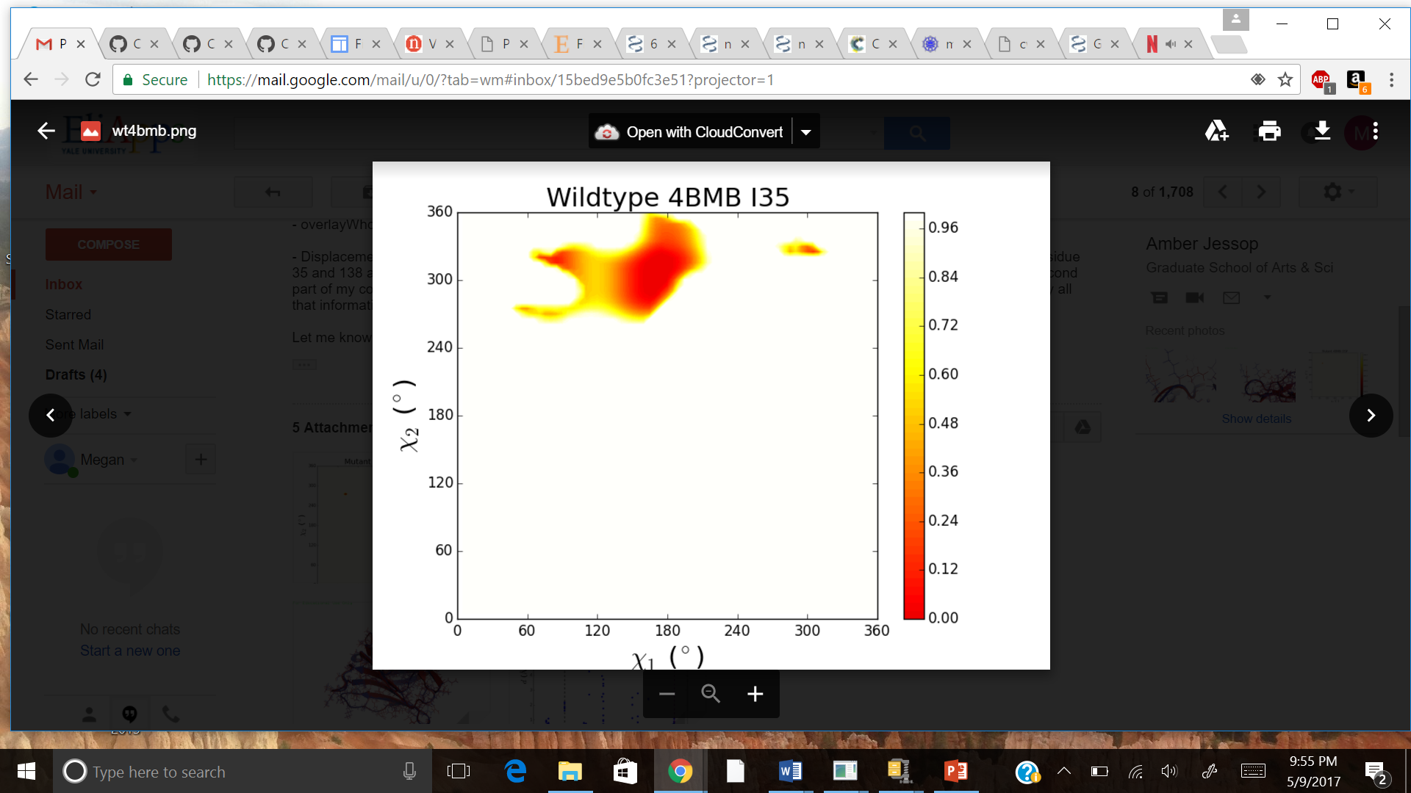
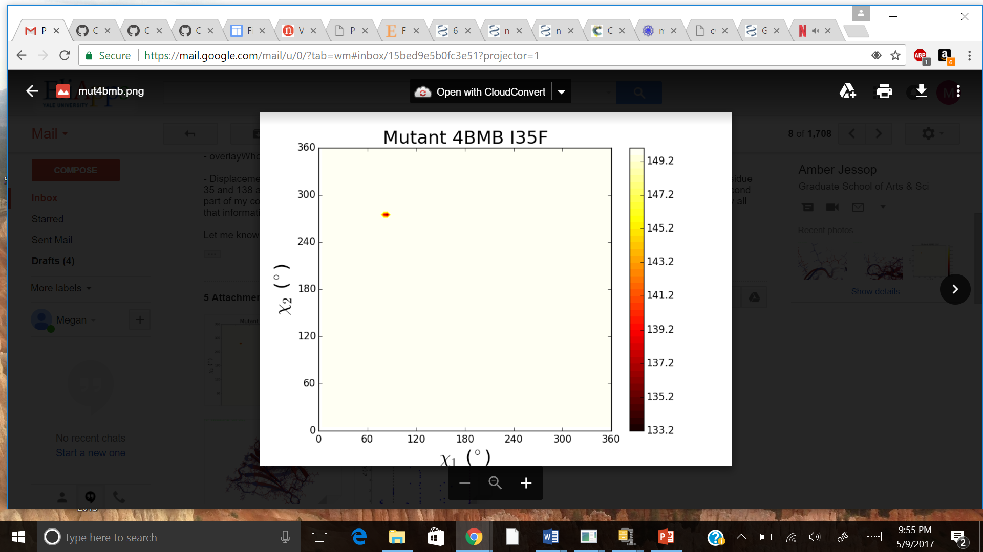
I35F Energy Plots

Slide 10
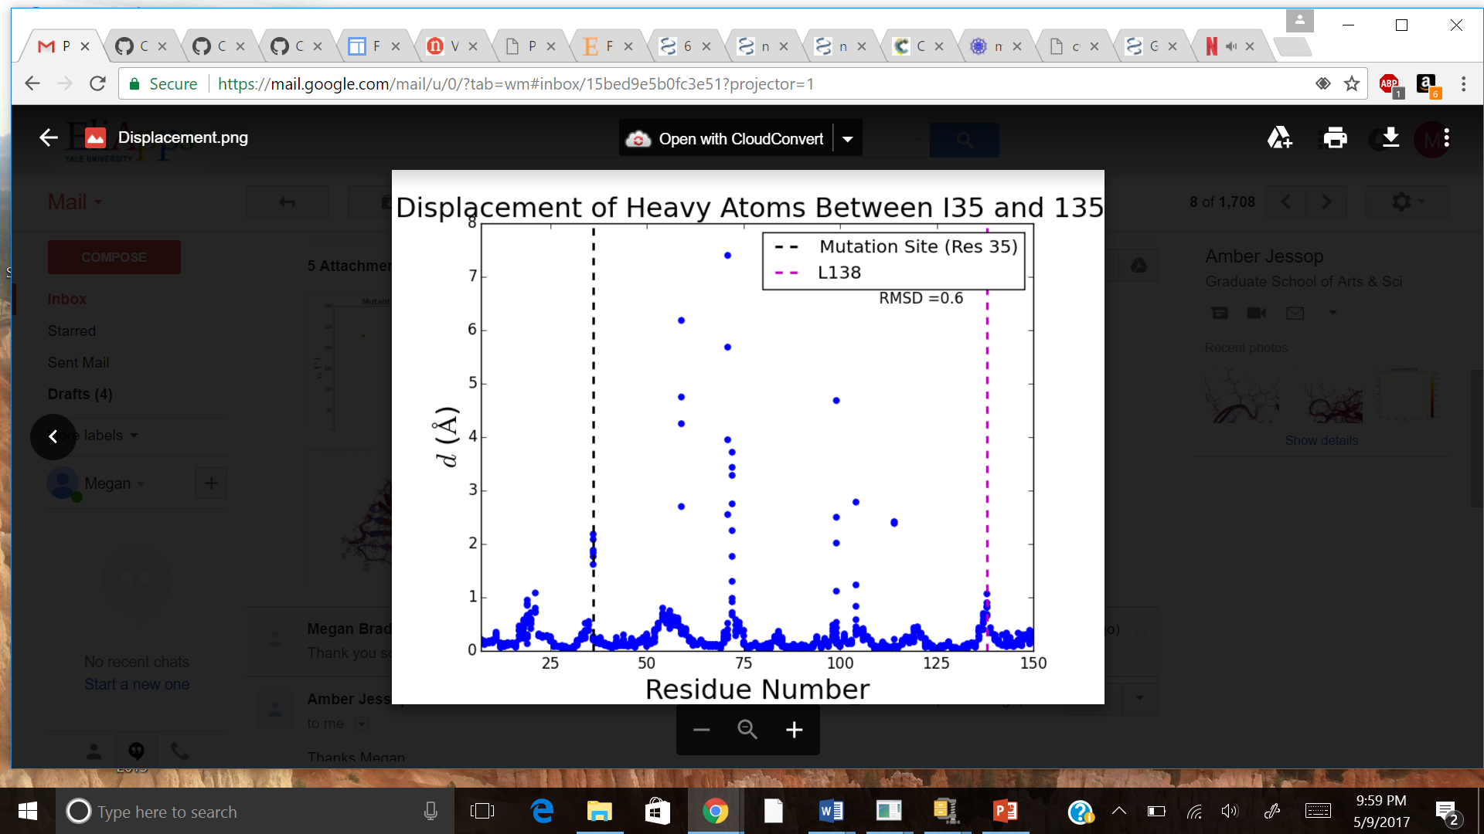
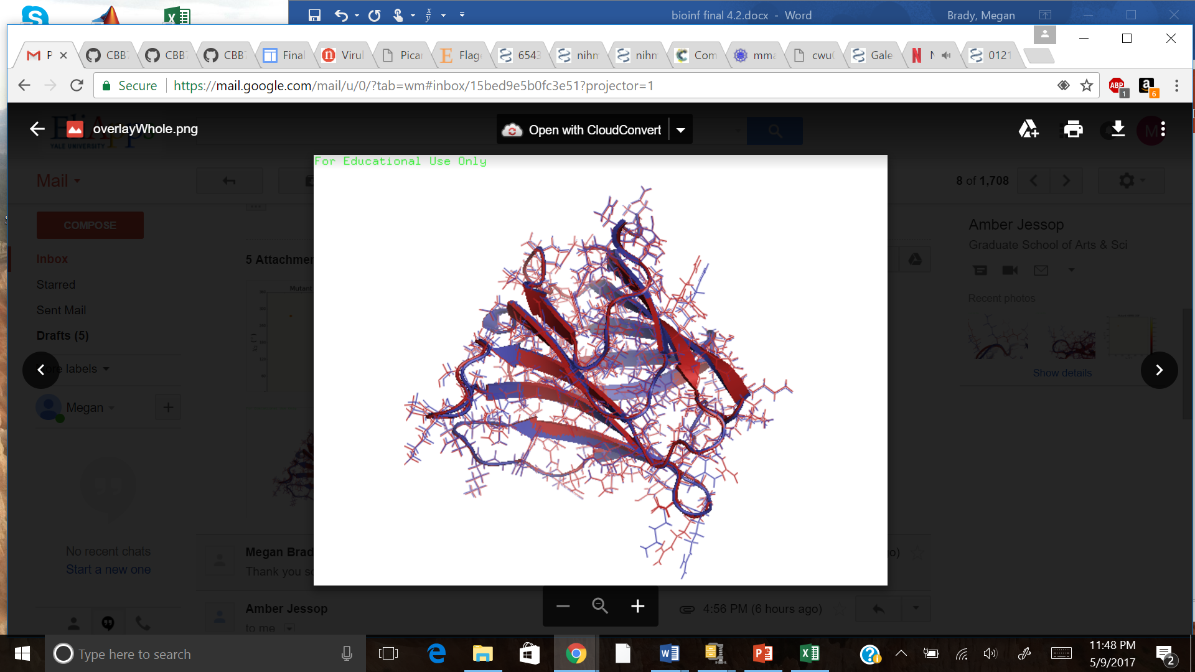
I35F RMSD Calculations
Overall heavy atom
RMSD: 0.591

Slide 11
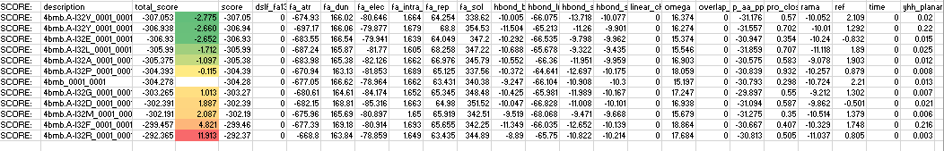
Pipeline: Rosetta
Mutation | Change in Energy (in REU)
I35V | -2.775
I35Y | -2.660
I35E | -2.652
I35L | -1.712
I35A | -1.097
I35P | -0.115
I35G | 1.013
I35D | 1.887
I35M | 2.087
I35F | 4.821
I35R | 11.913
Lennard-Jones attractive
Internal energy of sidechain rotamers (Dunbrack)
Electrostatic
Lennard-Jones repulsive (intraresidue and interresidue)
Lazaridis-Jarplus solvation energy
Sidechain-backbone hydrogen bond energy
Distant backbone-backbone hydrogen bond
Sidechain-sidechain hydrogen bond energy
Omega backbone dihedral
Overlap clashes
Probability at phi-psi angle
Ramachandran preferences

Slide 12
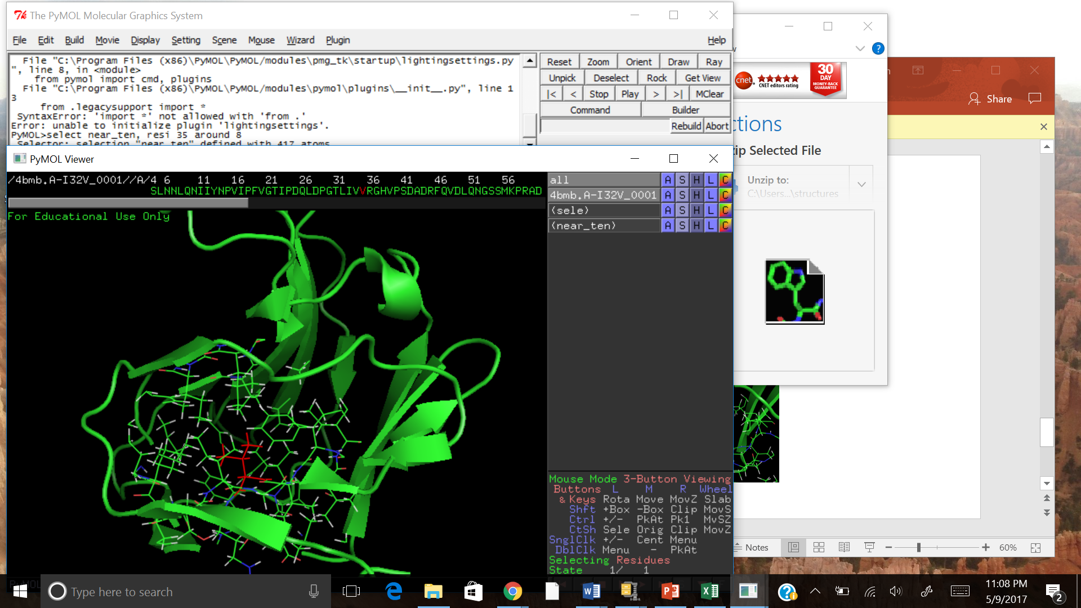
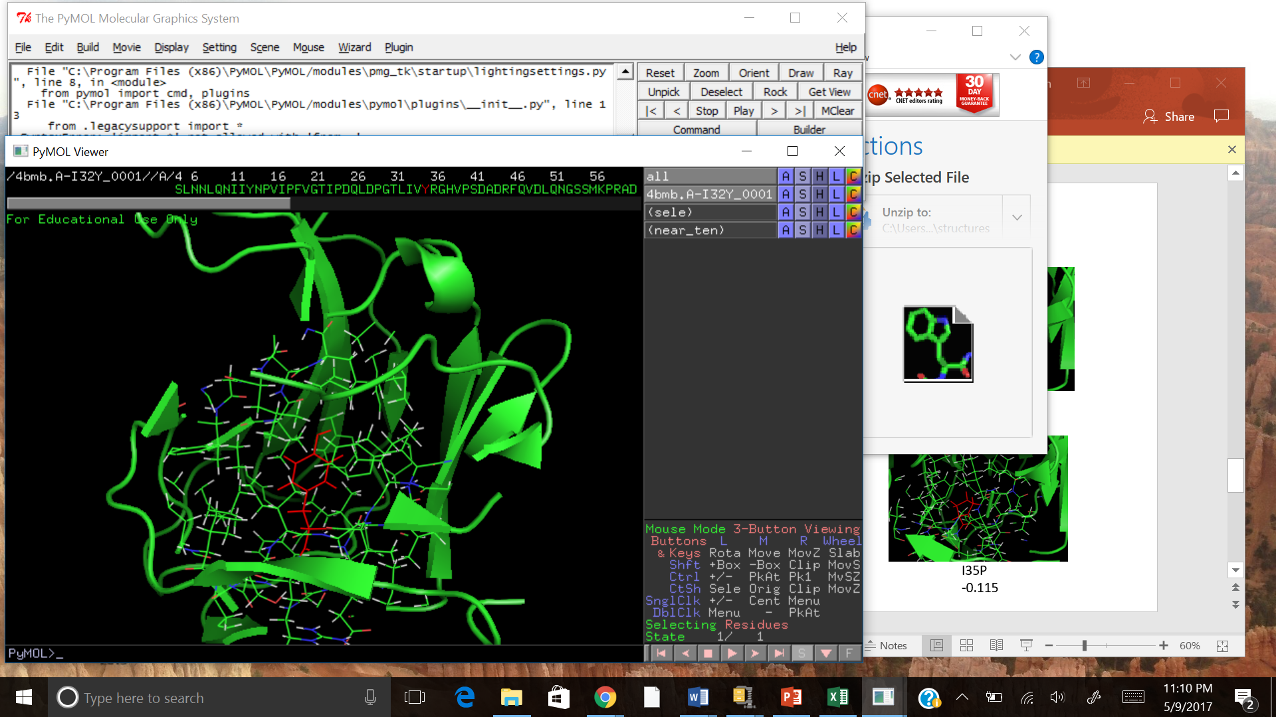
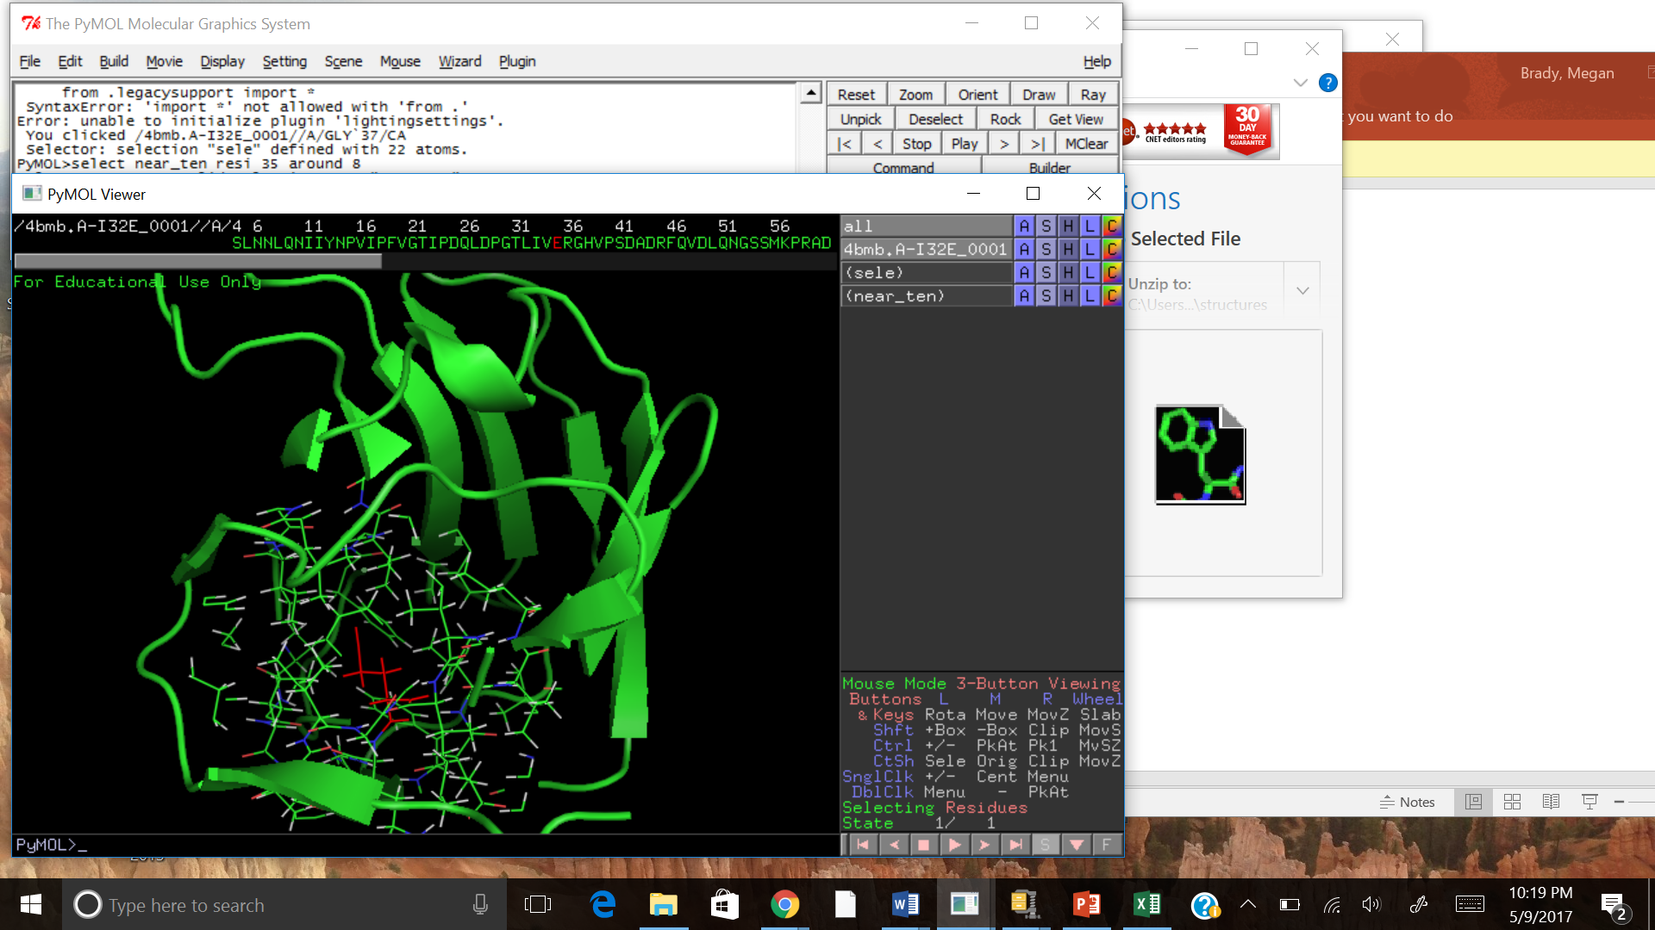
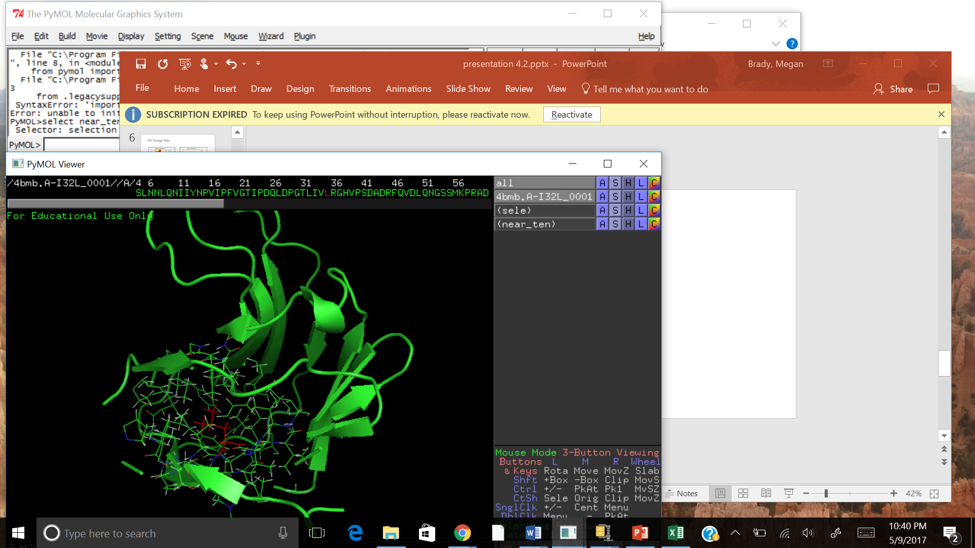
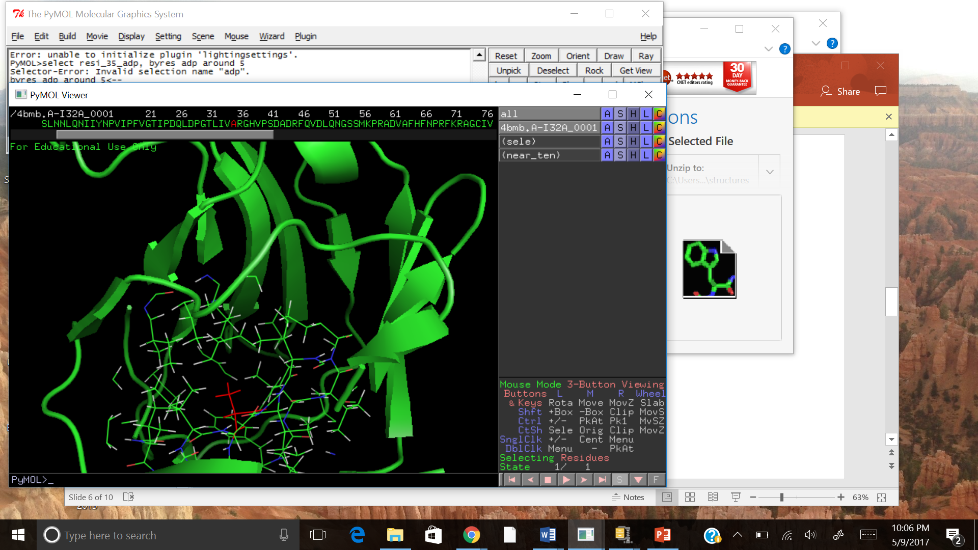
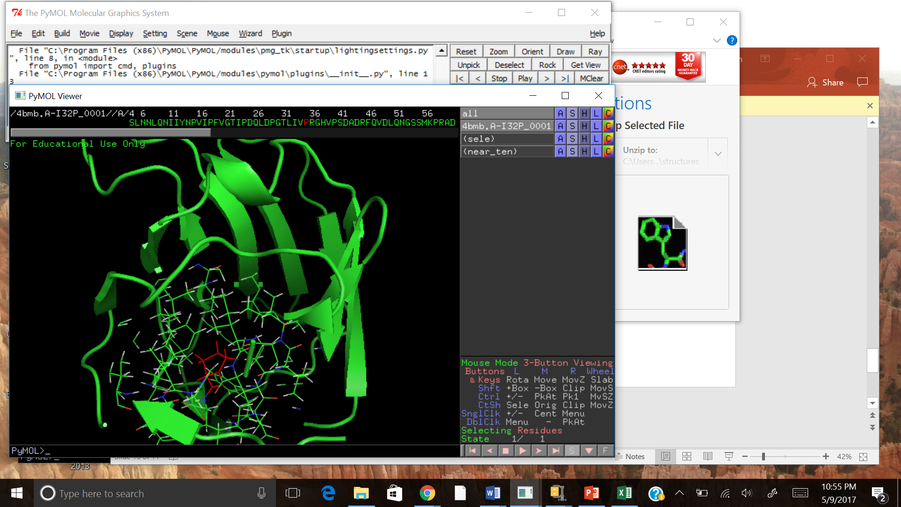
Favorable Mutations
I35V
-2.775
I35Y
-2.660
I35E
-2.652
I35L
-1.712
I35A
-1.097
I35P
-0.115

Slide 13
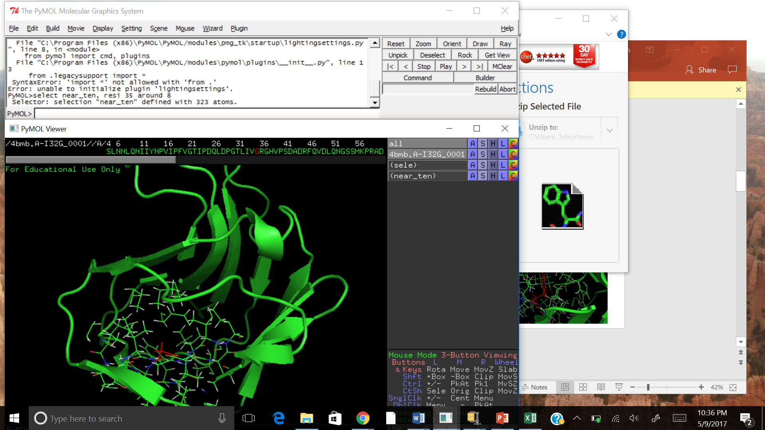
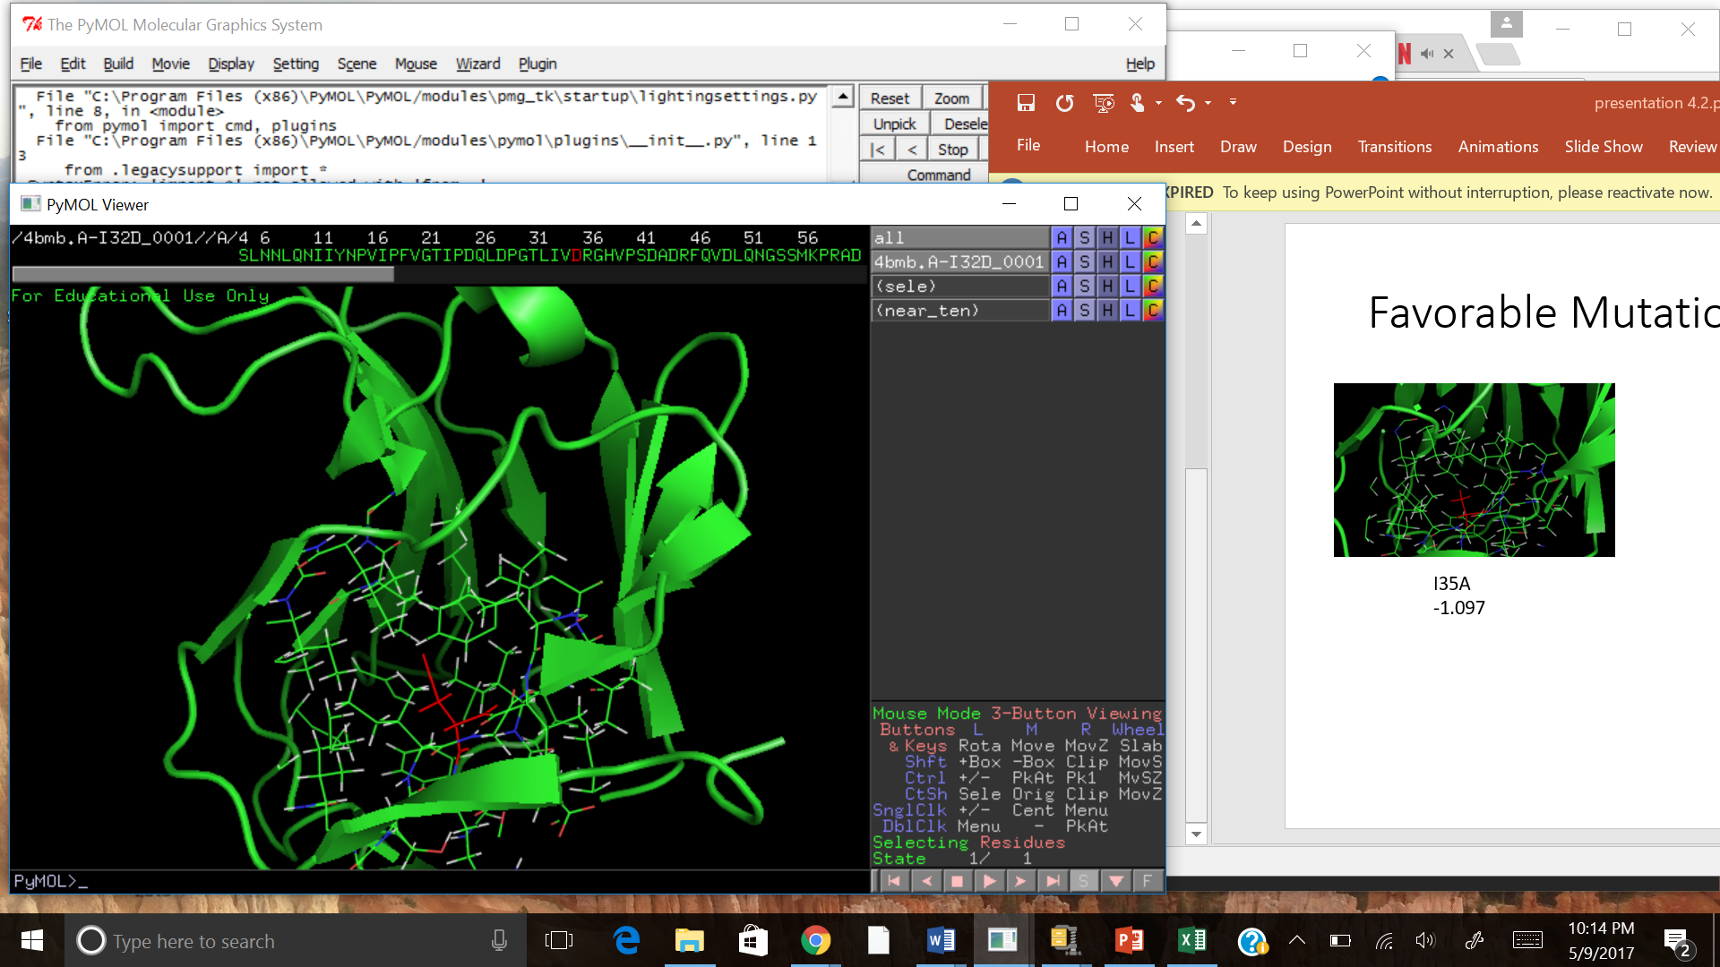
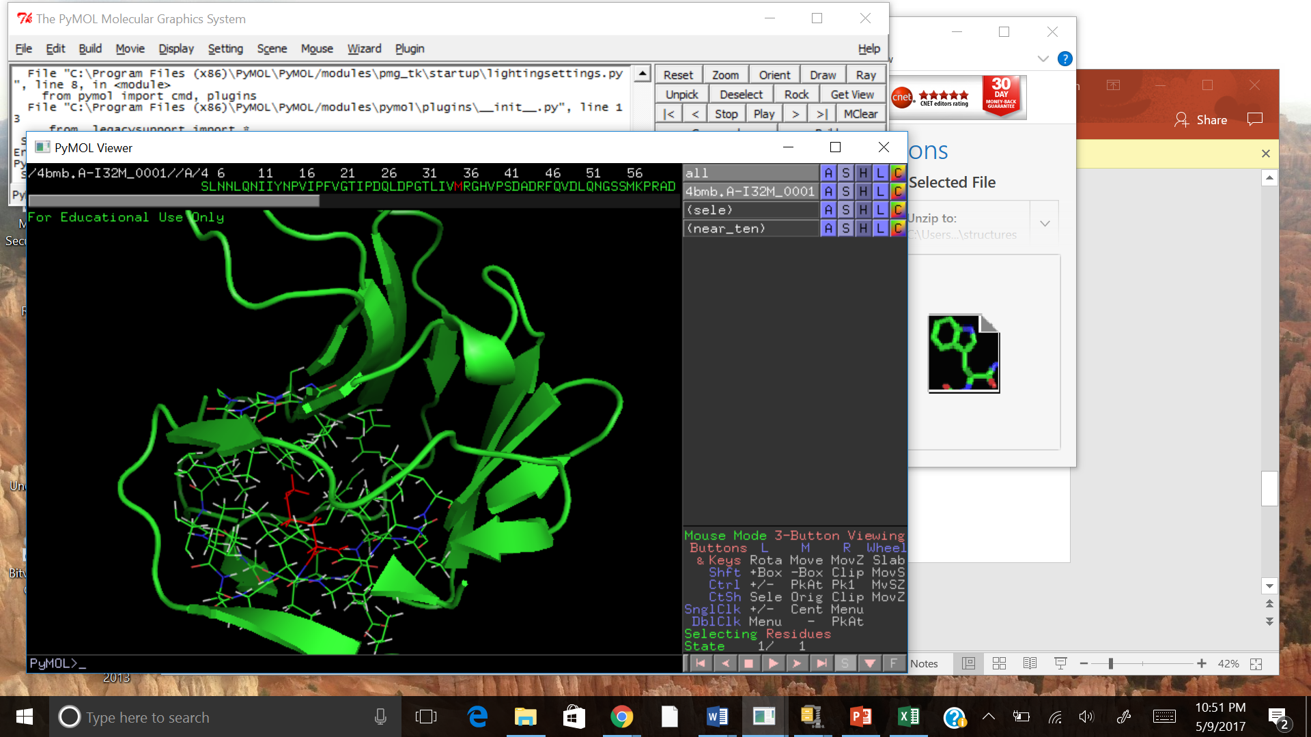
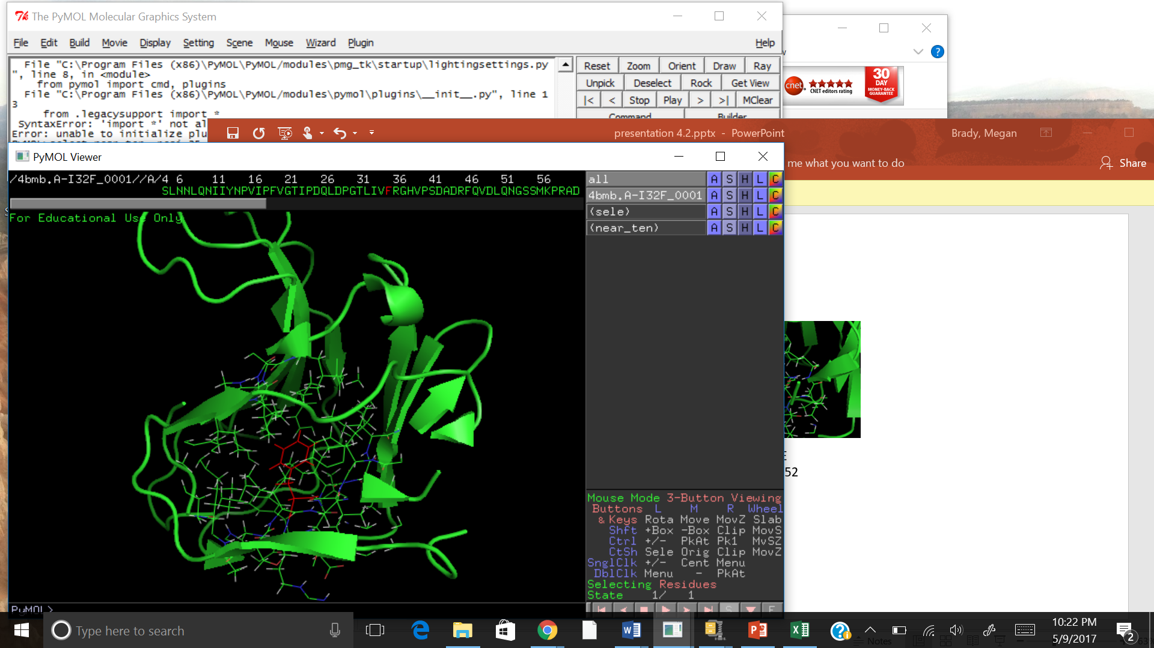
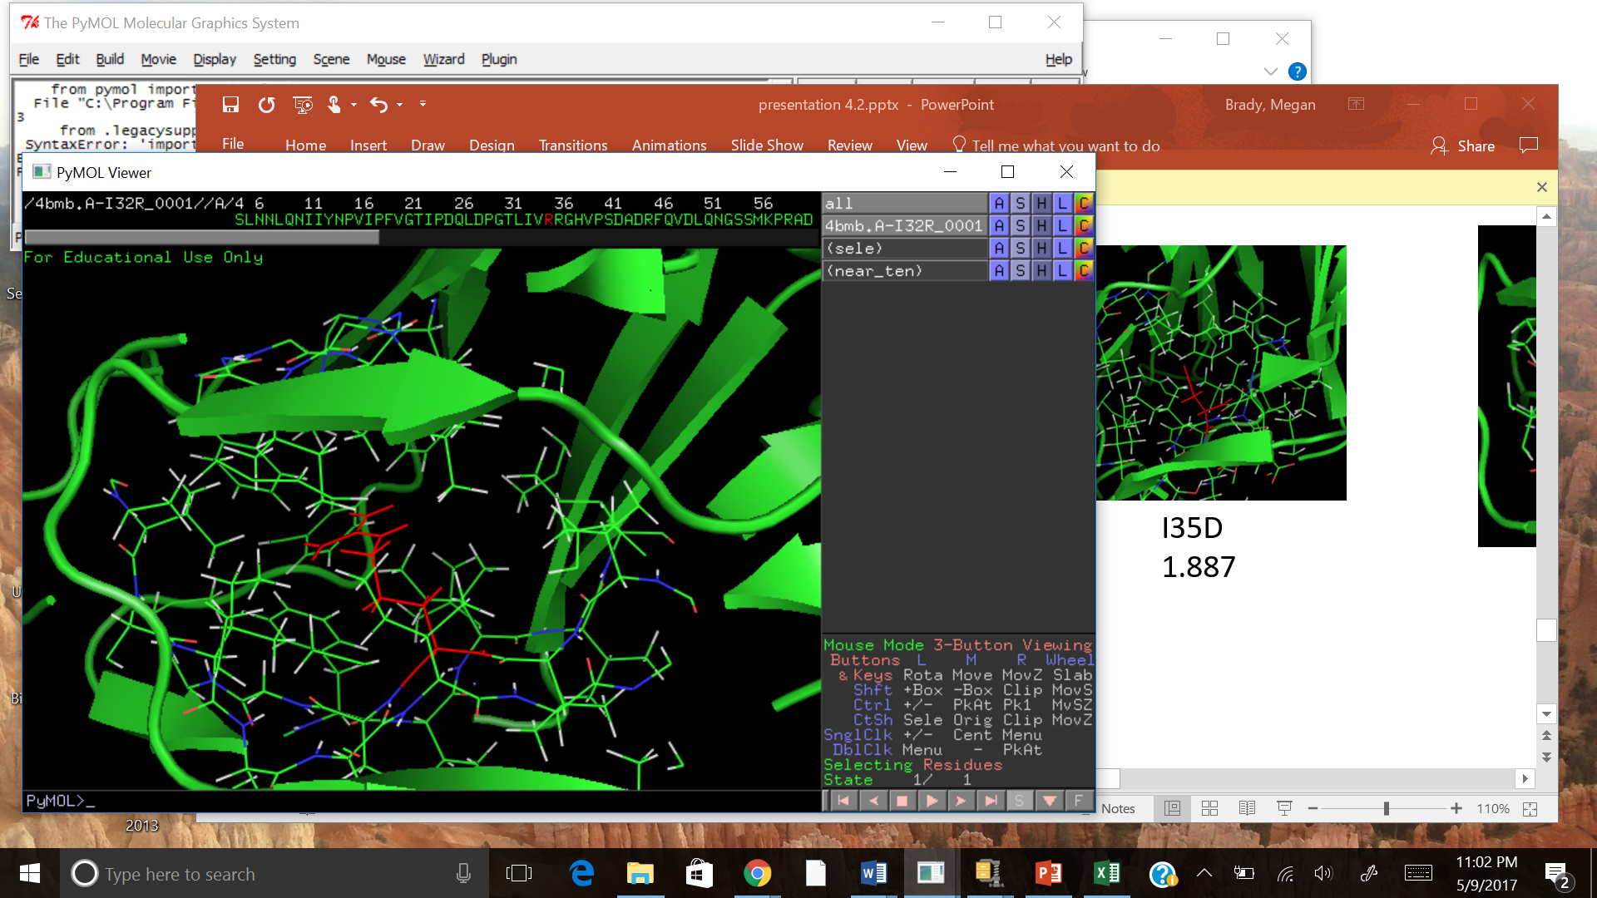
Unfavorable Mutations
I35G
+1.013
I35D
+1.887
I35M
+2.087
I35F
+4.821
I35R
+11.913

Slide 14
Conclusions
Size and charge important in predicting mutation effects
Side chain angle potential energies increased by I35F mutation
RMSD increased with I35F mutation
Unexpected mutation results (D/E, F/Y)
Interacting residues critical

